Slide 1
1. Introduction to Design Thinking

Slide 2
Summary
Introduction to design thinking
User Centered Design Process
Emphatize
Ideate
Get Feedback
Conclusions

Slide 3
CraftEase project
CraftEase is a web application solution developed for home improvement retailers who want to enhance customer engagement directly through their website. Our goal is to provide your store with an integrated digital service that helps manage DIY workshop registrations, promote project tutorials, and track tool/material availability in real time.
The platform is designed to be seamlessly embedded into your existing website. It is user-friendly, secure, and adaptable to your branding and customer needs. Features include personalized project recommendations, booking management, customer feedback tools, and analytics for store teams. By offering this added-value service, your store becomes more than a point of sale — it becomes a DIY destination.
Notes:
In this module, we use flipped learning. The goal is for students to experience the stages of design thinking before intellectualizing them. This is really important. We don't discuss the theory until the students have gone through the various stages. To go through these stages, we use a project.
Set up the room so that participants are in an active posture (sitting upright, standing), with access to a horizontal space for note taking.
Space should be configured to allow for participants to pair up near one another easily.
Cocktail style—small, standing height—tables are nice to have.
Play upbeat music during all steps while participants work, and turn it down to give instruction.
Make sure you have supplies on hand for prototyping (we recommend paper, pens, popsicle sticks, pipe cleaners, scissors, duct tape, and the like).
Print the participant worksheet on single-sided 11x17 paper. Print the facilitator’s guide on double-sided 11x17 paper.
Find a fun way to announce “Time’s up!” (we use a gong at the d.school).
Be assertive about keeping the timing tight.
If possible, have a TEAM of coaches who are familiar with the project share the responsibility for facilitating the learning experience.

Slide 4
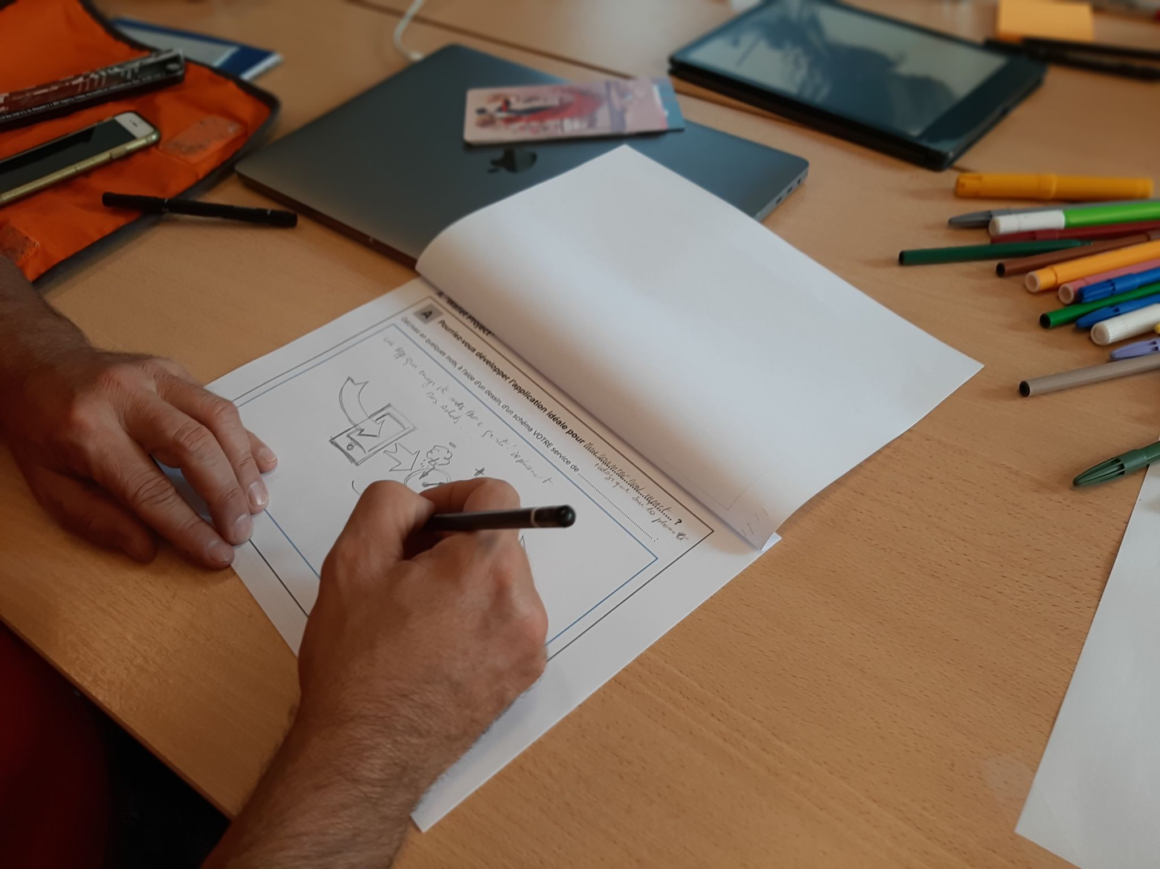
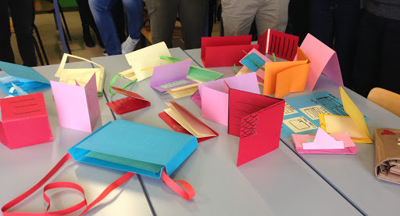
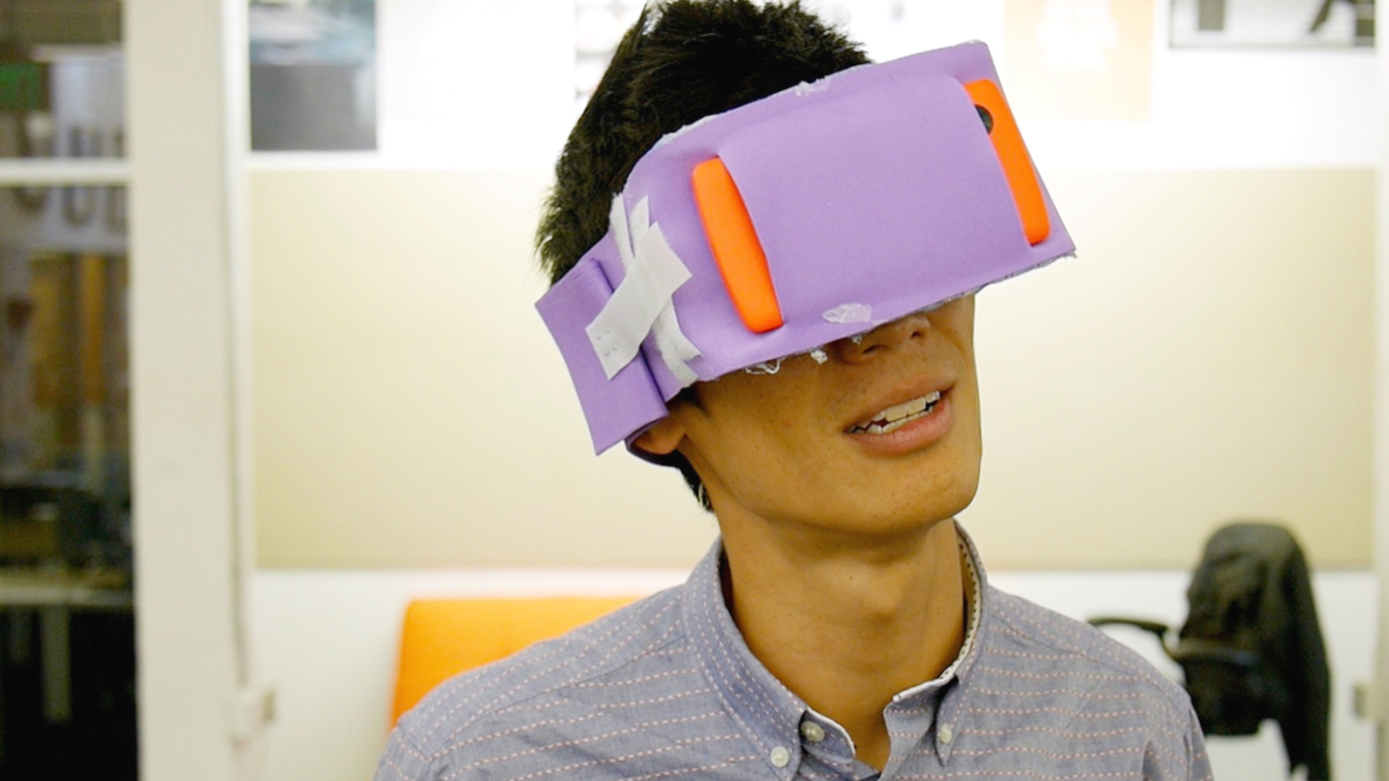

Today challenge : learning by doing
Notes:
The kick-off:
“Instead of just telling you about design thinking,
we want to immediately have you jump right in and experience it for yourself. We are going to do a design project for about the next hour.
Ready? Let’s go!”

Slide 5
Design your IDEAL DIY platform
Draw 3min
Sketch your idea here!
Notes:
This is what we call the “false-start”.
Of course, you don’t tell participants it is a false-start.
The intention is to contrast an abstract problem-centric approach (that may be typical for many people)
to a human-centered design thinking approach which participants will experience in the rest of the project.
Don’t play music during this step, to accentuate the difference between the false-start and the main part of the exercise.
“OK, let’s jump right in.”
" This is going to feel rushed; that’s okay. Roll up your sleeves and get ready to lean into the project.”
" Come up with some ideas for the ‘ideal’ learning platform.” “Go ahead and draw an idea for a better learning platform.”
Let them know how much time they will have.
It is normal for people to feel stuck and delay putting anything down on paper. Reminding them of the time they have left can push them to start.
. . . At the end of the step:
"How did that feel? My guess is, ‘Not great.’”
“That was a typical problem-solving approach, taking on a given problem, working using your own opinions and experience to guide you, and with a solution in mind to be designed.” “Let’s try something else—a human-centered design thinking approach.”

Slide 6
2. User Centered Design Process
Notes:
Before next activity, this chapter explains the main concept of User Centered Design Process

Slide 7
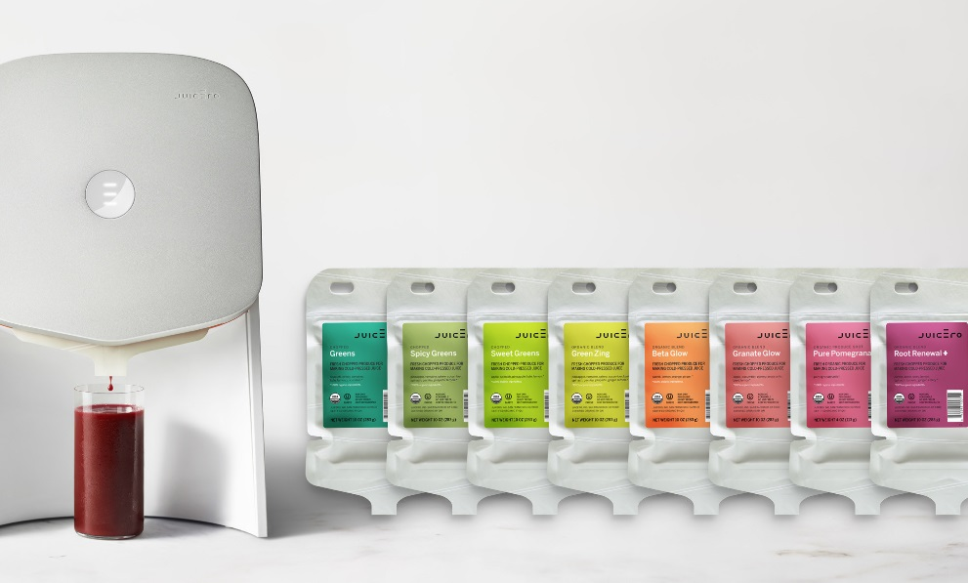
The Juicero story
Lack of user empathy: Misunderstood juice needs
Wrong problem focus: Solved non-existent issue
Over-engineered solution: Unnecessary complexity
Expensive prototype: $699 for 400 custom parts
Poor user testing: Missed obvious flaws
Failed to pivot: Ignored market feedback
Notes:
Here, we explain, using the example of Juicero, which aimed to do for juicing what Nespresso machines did for coffee but using veggie-based juices, that their failure was due to a misunderstanding of user needs and a lack of user testing.

Slide 8
Creative Process
Preparation
Inspiration
Production
Validation
Restitution
Notes:
Here, we describe the creative process by first outlining the preparation phase. Then, we enter a loop involving inspiration, followed by production and validation. This loop is repeated several times until we are ready, and finally, there is a presentation when we're prepared to enter the market.

Slide 9

Lean start-up
"There are no facts inside the building, so get the hell outside!"
Steve Blank
Source OpenAI
Notes:
When we talk about design thinking, we also talk about Lean Startup. Here, we introduce Lean Startup with Steve Blank, who recommends getting out of the building to understand user needs rather than thinking in a research office.
Lean Startup is a method of creating a business (or launching a project) that aims to reduce risk and waste by quickly learning what users really want.
🔍 The key principle: Rather than spending months developing a “perfect” product that might not please, we start by creating a simplified version of the product called MVP (Minimum Viable Product), which we very quickly put in the hands of users to gather their feedback.
🔁 The Build - Measure - Learn loop: Build an MVP quickly,
Measure user feedback (behaviors, feedbacks),Learn from this data to adapt the product (pivot or improve).
🎯 Objective: Launch a product that truly meets market needs, minimizing costs, time and effort.

Slide 10
3. Empathize

Slide 11
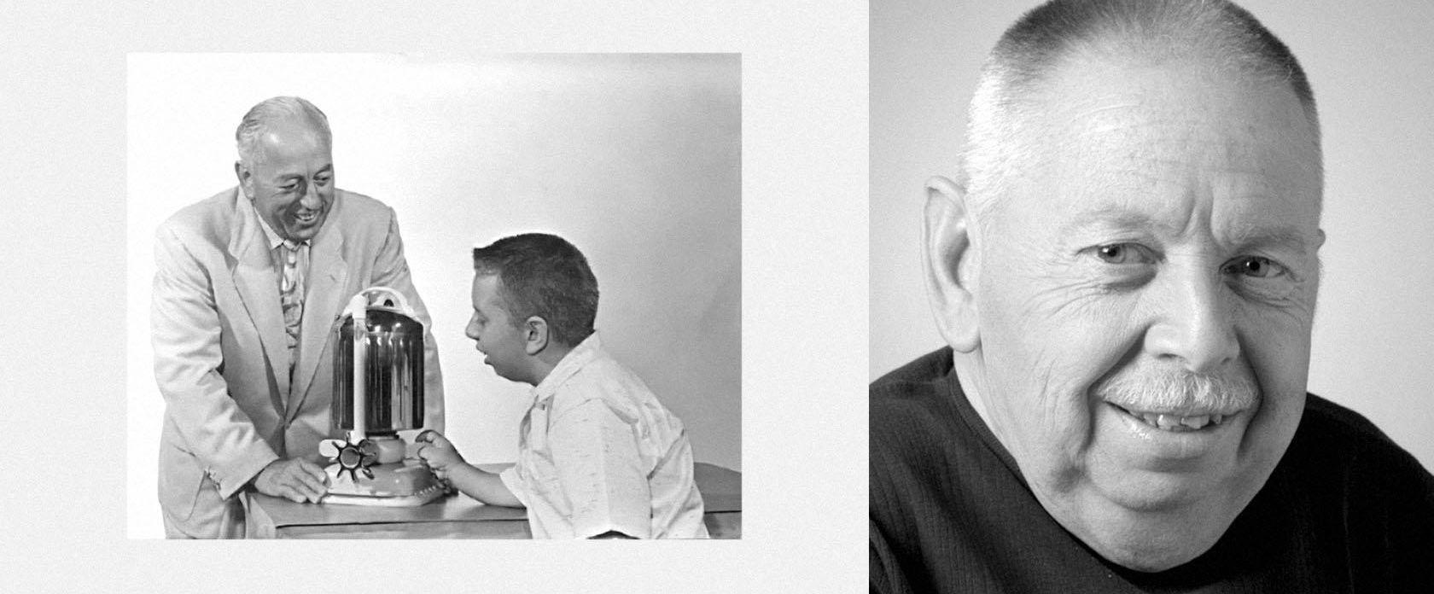
Jacuzzi Story
https://blog.jacuzzi.co.uk/
Notes:
Here's the story of a family. In this tale, a child suffers from an illness that hinders normal development, particularly affecting the joints. The only thing that helps is taking warm baths with a nurse at the hospital who creates waves in the water. Seeing the child's relief, the father and uncle, who were working for a company that got rich from making pumps for fighter jets during World War II, decide to install a pump in their home bath to mimic the nurse's movements. It works remarkably well. The hospital is very interested and purchases pumps. People begin to realize the benefits and relaxation provided by this method. Sports clubs then start buying the device. Eventually, the Jacuzzi family discovers new product opportunities. End of story. The little boy shown in the picture on the right grew up and lived a happy life.

Slide 12
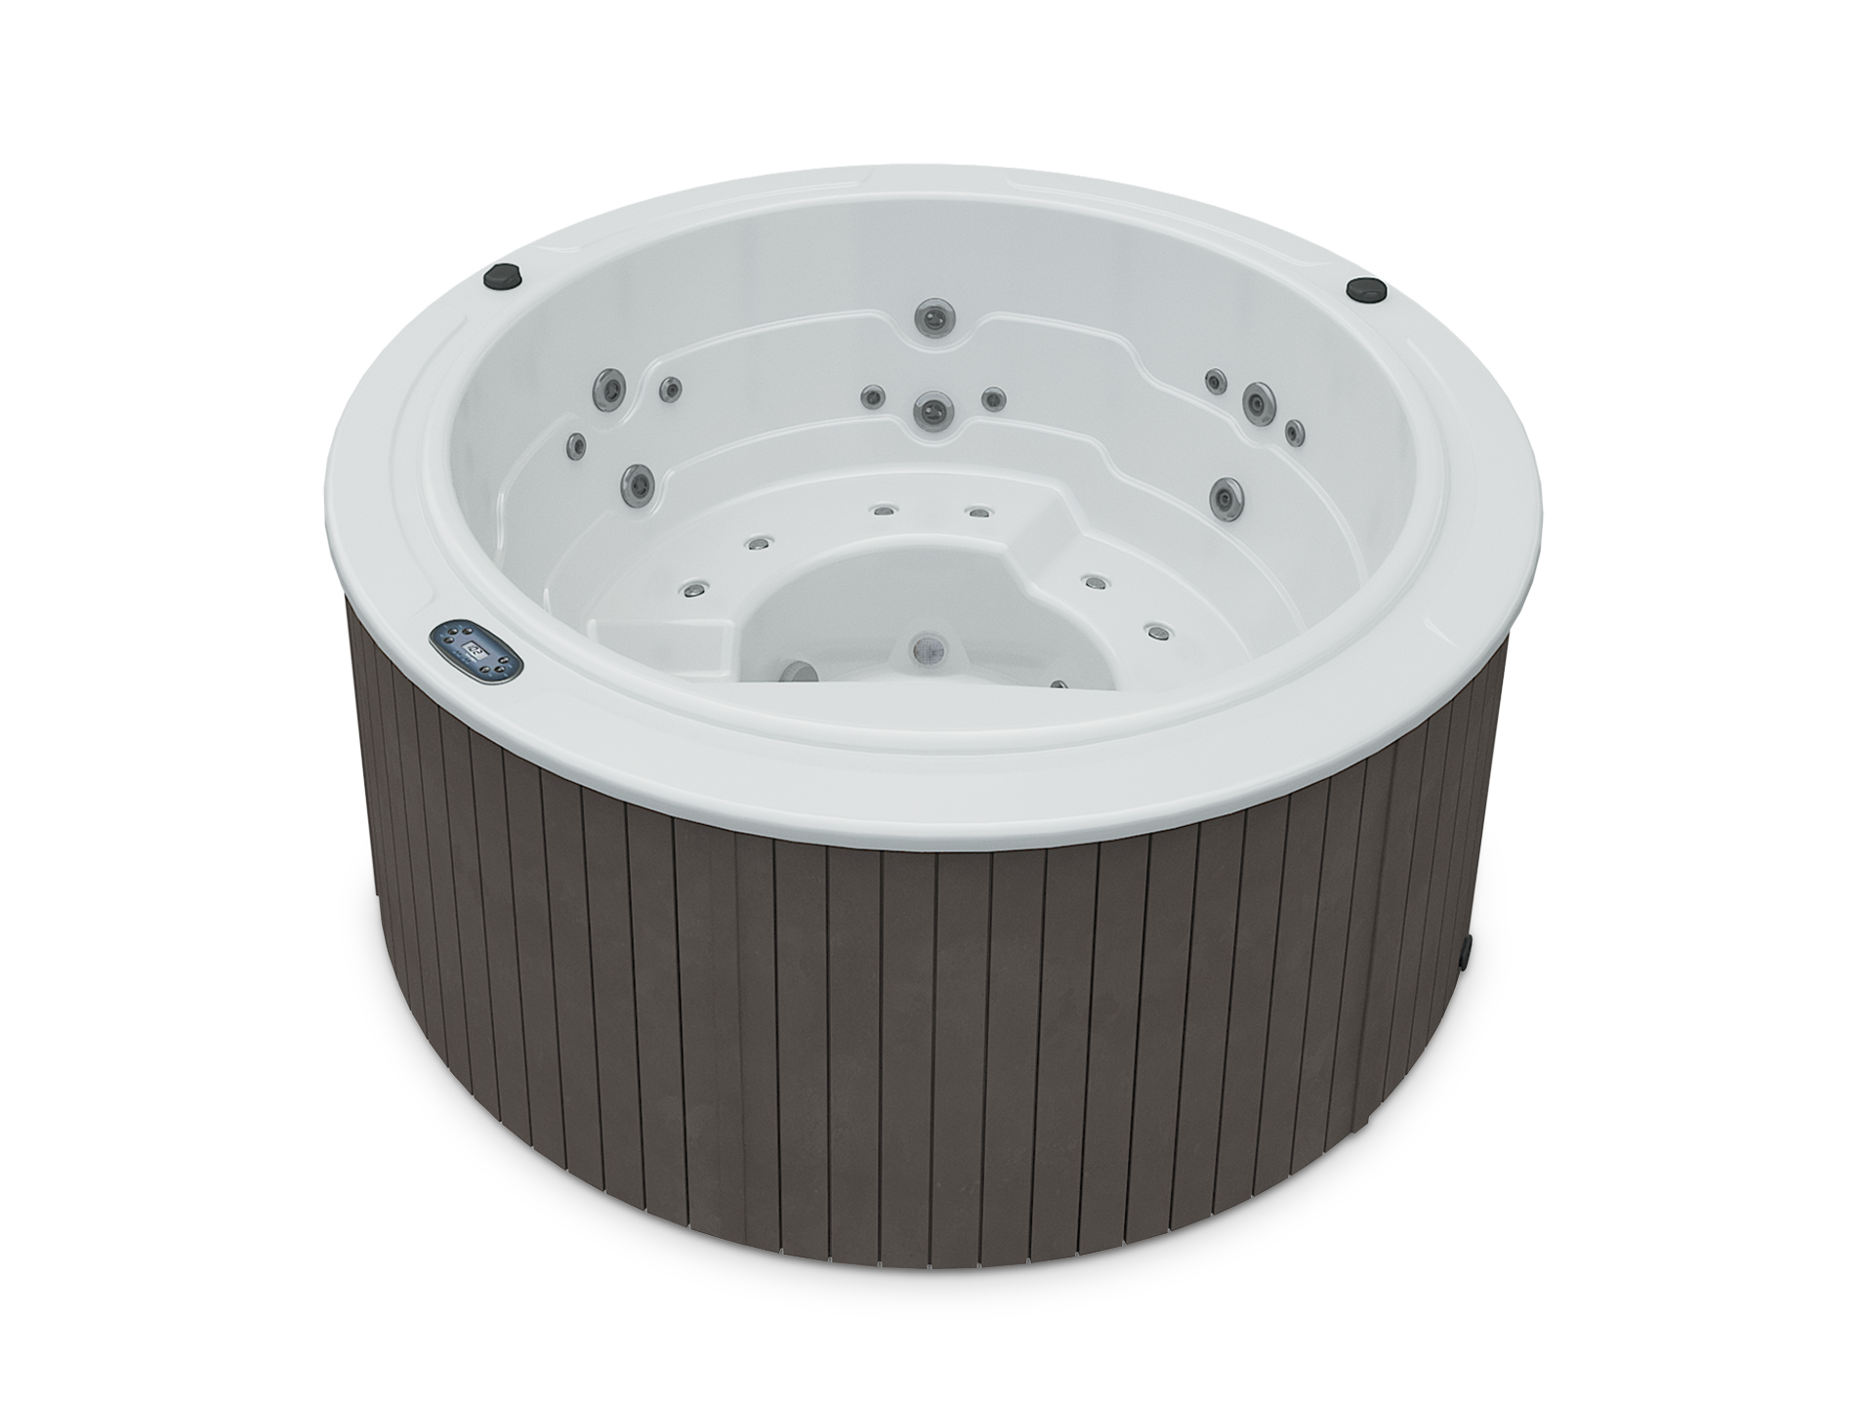
Jacuzzi Story
Jacuzzi: A lesson in empathy-driven design
Motivation: Candido Jacuzzi's son had rheumatoid arthritis
Empathy: Father understood son's pain firsthand
Innovation: Adapted agricultural pump for hydrotherapy
User-focused: Created portable pump for bathtub use
Unexpected success: Gained popularity beyond initial purpose
Evolution: Led to modern hot tub and spa industry
Key takeaway: Empathy can drive innovation with broad market appeal
https://blog.jacuzzi.co.uk/
Notes:
What we take away from the story of the jacuzzi is that by empathizing with a person's needs and using existing devices, meaningful innovation is possible.

Slide 13
Design something useful and meaningful for your partner. Start by gaining empathy.
1 Interview
2 Dig Deeper 6min (2 sessions x 3 minutes each)
8min (2 sessions x 4 minutes each)
Notes from your first interview
Notes from your second interview
Switch roles & repeat Interview
Switch roles & repeat Interview
d.
Notes:
1—Interview your Partner
Have participants partner up in pairs.
It helps to refer to “Partner A” and “Partner B” to simplify your language in these interactive steps.
“Your challenge is to design something useful and meaningful to your partner.”
“The most important part of designing for someone is to gain empathy for that person.”
“One way to do this is to have a good conversation.”
Be clear about the logistics of the interviews:
“Partner A will have four minutes to interview Partner B, and then we will tell you when to switch.”
“When do they use learning material? Why do they discuss with teachers? "
Tell them to take note of things they find interesting or surprising.
“Let’s begin!” (Don’t forget to start playing the upbeat music now.) it's any kind of music that's played when the participants are doing the exercises. It sets the mood ;-)
2—Dig deeper => before this step, explain the following slides.

Slide 14

User interview: deep dive
Ask who, what, when, why
Explore problems
Ask for priorities
Avoid answered questions
Rephrase with no judgment
Don't be afraid of silences
Act as you don't understand
Use open questions
Notes:
Here are some tips and tricks for conducting interviews effectively. The key is to open the conversation and explore the needs in depth. It's essential to avoid closed questions.

Slide 15

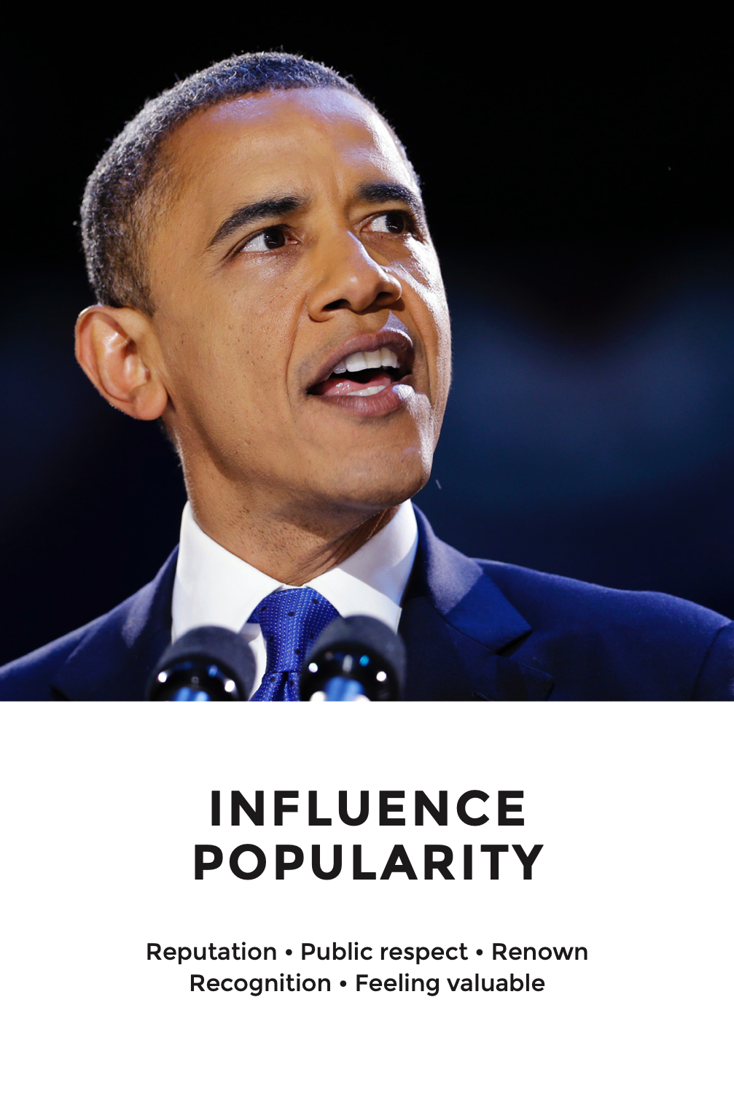



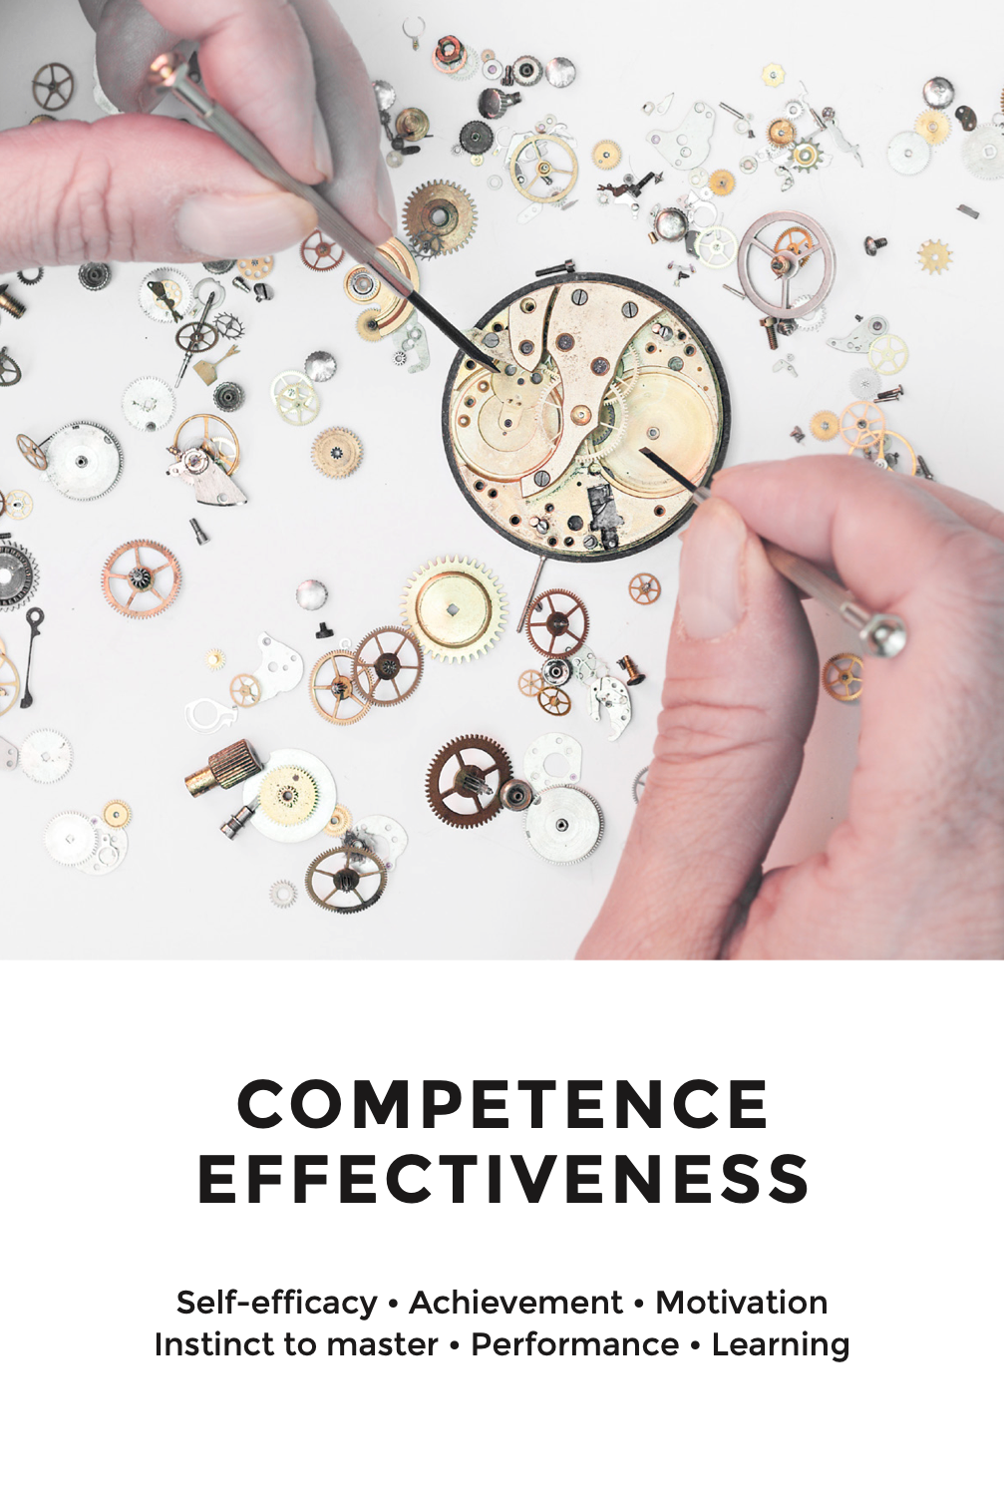


UX Cards
A powerful toolkit for UX designers and researchers.
These cards offer a practical, hands-on approach to user experience design, helping teams ideate, prototype, and evaluate more effectively. By simplifying complex UX concepts, Lallemand's cards bridge the gap between theory and practice, making user-centered design accessible to all.
Notes:
Here we present a perspective on user needs using Sheldon’s theory of needs. The idea is that a need that is met will lead the user to be more satisfied and therefore more motivated. Here is a version of the UX cards adapted by Carine Lallemand.

Slide 16
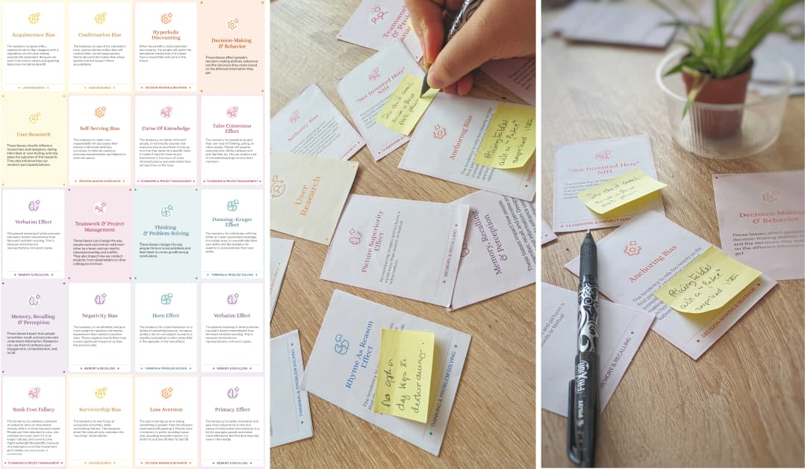
Cognitive Biases
- Confirmation bias: The tendency to search for, interpret, favor, and recall information in a way that confirms or supports one's prior beliefs or values
- Subjective validation: The cognitive bias by which people will consider a statement or another piece of information to be correct if it has any personal meaning or significance to them
- Primacy effect: The tendency for people to better remember and be influenced by the first piece of information they encounter
- Observer bias: The tendency of observers to not see what is there, but instead to see what they expect or want to see, potentially influencing research outcomes
Source : Stéphanie Walter
Notes:
Here, we present four main cognitive biases encountered during interviews or co-creation sessions.

Slide 17
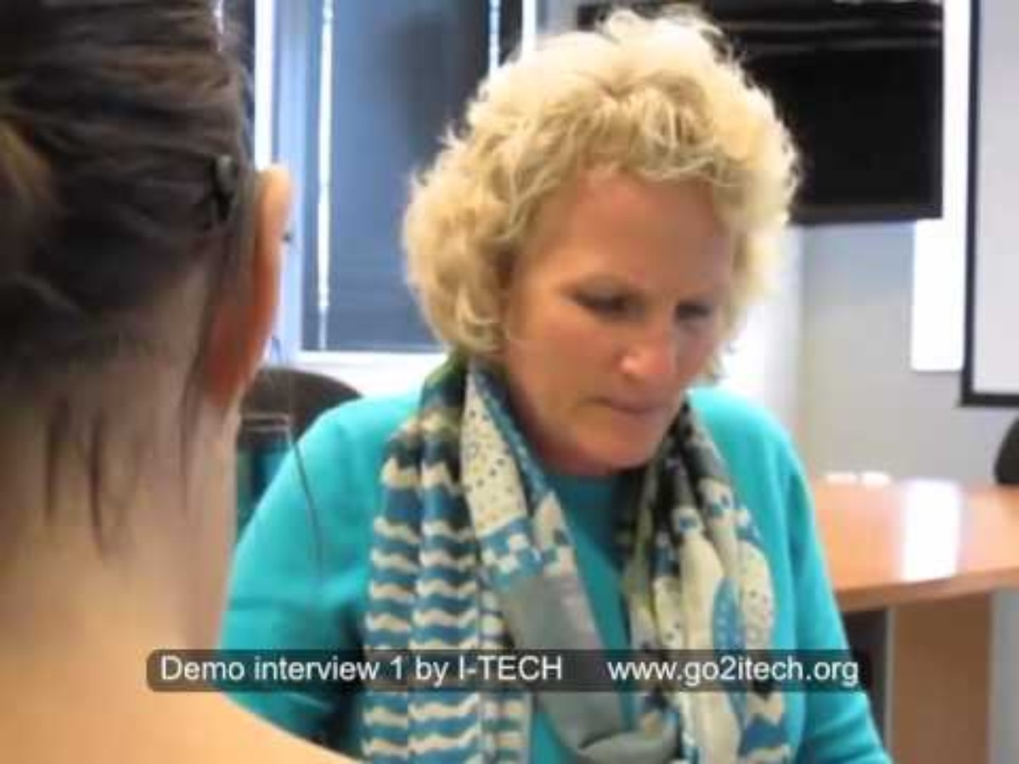
User Interview: counterexample
Find 7 mistakes in this interview.
Demo qualitative interview with mistakes
Notes:
You need to show the video here and ask the learners to find at least seven mistakes that occur during the video. Then, we'll debrief.

Slide 18

User Interview: correction
How it should be done!
Demonstration Qualitative Interview - how it should be done
Notes:
Now, we show the video of the interview as it should have happened. We encourage learners to notice the difference with the first video.

Slide 19
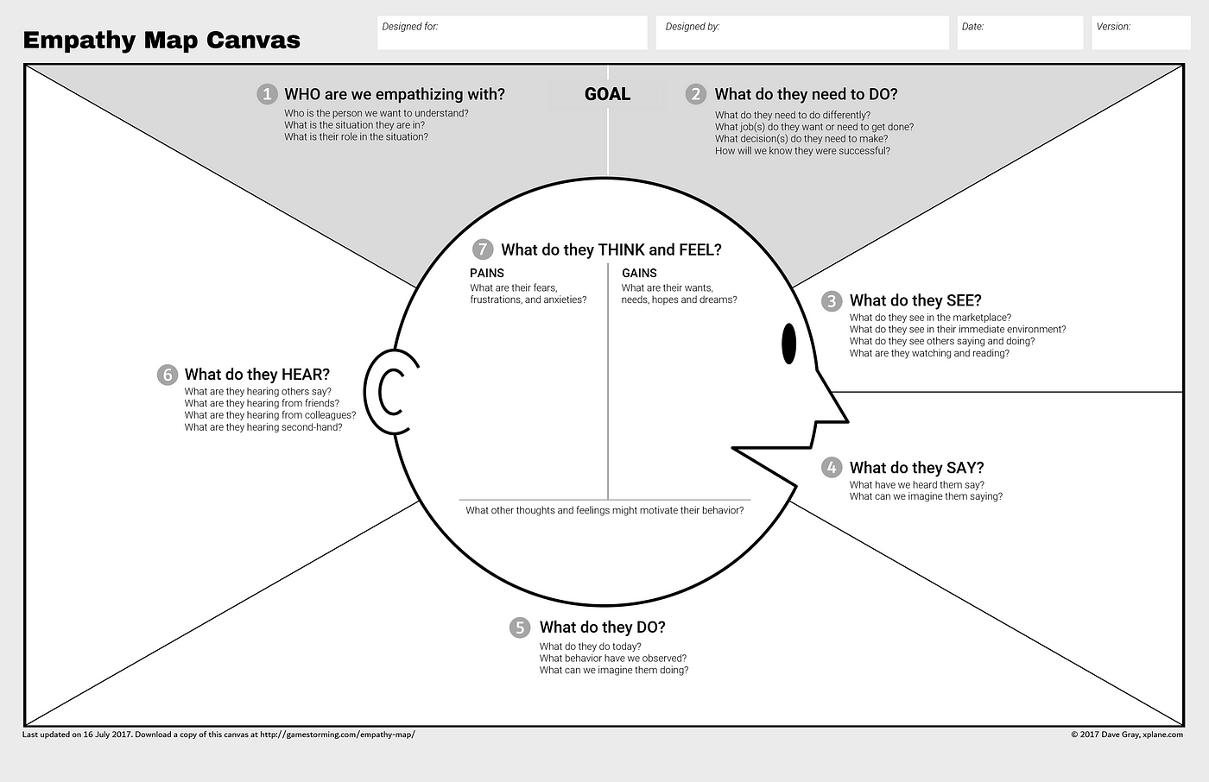
Complete an empathy map
Notes:
Ask participants to check if all the cases in the Empathy could be completed thanks to the interview. 2- Dig Deeper
After the first set of interviews, tell them to follow up on things that intrigued them during the first interview.
“Try to dig for stories, feelings, and emotion.” “Ask ‘WHY?’ often”
“Forget about the platform, find out what’s important to your partner.”
"Remind them you will let them know when time is up.
. . .“Time to switch! Again, make note of any unexpected discoveries along the way, capture quotes!”

Slide 20
4. Ideate

Slide 21
How Might We technique
Purpose: Transforms challenges into opportunities for innovative solutions in design thinking.
Framing: Uses open-ended questions starting with "How might we..." to encourage creative thinking and collaboration.
Encourages Divergence: Promotes a wide range of ideas without immediate judgment, fostering an environment for brainstorming.
Collaboration Focus: Emphasizes teamwork, allowing diverse perspectives to contribute to problem-solving.
Application: Useful in various stages of design processes, such as defining problems, ideating solutions, and refining concepts.
Outcome: Generates actionable insights that guide the development of user-centered products and services.
Notes:
Here, we present the How-Might-We technique. It's a method that helps rephrase the conclusions found during interviews into challenges to be solved.

Slide 22
How Might We technique
Examples :
How might we help educators save time by simplifying repetitive tasks?
How might we make learning more engaging and interactive for students?
How might we provide learners with clear, actionable insights about their progress?
How might we help educators and learners experience the benefits of a digital learning platform without relying on technology?
How might we design a tool that adapts to different teaching styles and learning needs?
How might we encourage collaboration between educators and learners in a seamless way?
How might we ensure that the platform remains easy to use while being innovative?
Notes:
Here, we present the How-Might-We technique. It's a method that helps rephrase the conclusions found during interviews into challenges to be solved.

Slide 23
How Might We technique – Tips and tricks
Tips for Creating Effective "How Might We" Questions
Avoid suggesting solutions in the rephrasing
Keep the question sufficiently broad
Focus on the benefit for the user
Formulate the question positively
Examples :
1. Avoid suggesting solutions
✅ How might we help educators track student progress more effectively? ❌ How might we create an AI-powered dashboard to track student progress?
2. Keep the question sufficiently broad
✅ How might we make it easier for educators to manage their daily tasks? ❌ How might we create a mobile app to help educators schedule their lessons?
3. Focus on the benefit for the user
✅ How might we help students stay motivated and engaged in their learning journey? ❌ How might we develop a scalable e-learning platform with gamification?
4. Formulate the question positively
✅ How might we support students in overcoming learning challenges more easily? ❌ How might we prevent students from losing interest in their courses?
Notes:
Here we show tips and tricks for writing great challenges.

Slide 24
Reframe the problem in HMW template
Identify Key Insights – Review user interviews and extract key pain points or needs.
Define the Core Problem – Reformulate each insight into a clear problem statement.
Turn It into a HMW Question – Reframe the problem into an open-ended How Might We question to spark ideation.
Ensure It’s Broad but Actionable – Avoid solutions in the question; keep it open enough for creativity but focused on the challenge.
Notes:
I ask the students here to reframe their conclusion as a challenge.

Slide 25
Ideate: generate alternatives to test
Sketch at least 5 radical ways to meet your user’s needs.
5 min
Notes:
Have them rewrite their problem statement at the top of the page. (see slides 21-22 -23)
Remind them they are now creating solutions to the new challenge they’ve identified.
Ask them to sketch a lot of ideas for the problem, and to try to create a number of different ideas.
“GO FOR VOLUME!”
“This is time for idea generation, not evaluation—you can evaluate your ideas later.”
You can even suggest a friendly competition to come up with the most ideas --
“See if you can come up with at least 7 ideas!”
Remind them they are not necessarily designing a platform; instead they should create solutions to problem statement they just created.
“Remember to be VISUAL—use words just when necessary to call out details.”
... “One minute left! Try to sketch at least 2 more wildly different ways to address your problem statement!”

Slide 26
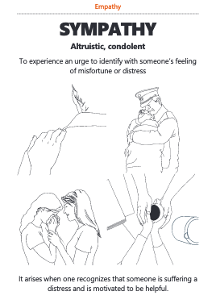
Boosting Ideation with Positive Emotional Granularity
Why Emotional Granularity Matters in Ideation?
Enhances Creativity: The more precisely we define emotions, the more diverse and innovative ideas emerge.
Encourages Empathy: Understanding nuanced emotions helps design solutions that truly resonate with users.
Strengthens Communication: Using specific emotional terms refines team discussions and ideation sessions.
manual-v06.pages
Notes:
Here are the cards of positive emotions that help guide the design and challenge idea proposals.

Slide 27
Boosting Ideation with Positive Emotional Granularity
How to Leverage Positive Emotional Granularity in Ideation?
Explore a Richer Emotional Vocabulary: Instead of "happy," consider "joyful," "grateful," "curious," or "inspired."
Use Emotion-Based Prompt Cards: These tools help teams explore a variety of positive emotions and their nuances.
Map Emotions to User Experiences: Identify key moments in a user’s journey that trigger specific emotions.
Use Emotions as a Springboard for Ideas: Ask, “How might we design an experience that evokes [specific emotion]?”
Encourage Emotional Storytelling: Have users or team members share moments tied to a particular emotion to inspire new concepts.
manual-v06.pages
Notes:
Here, we explain how to use ideation cards focused on emotions.

Slide 28
Expanding Ideation with "What If" Prompts
Why Use "What If" Questions in Ideation?
Stimulates Creative Thinking: Encourages teams to break out of conventional patterns.
Challenges Assumptions: Helps uncover new perspectives and opportunities.
Generates Unexpected Solutions: By shifting contexts, teams explore ideas they wouldn’t normally consider.
What if our product was designed for a completely different audience?
What if we removed a core feature instead of adding one?
What if our service worked like a game?
What if users could interact with it using only voice commands?
What if constraints (budget, time, space) were removed?
Notes:
Similarly for brainstorming, we use "what if?" questions. This helps challenge ideas and reinvigorate creativity.

Slide 29
Expanding Ideation with "What If" Prompts
How to Use "What If" Cards?
Frame the Challenge: Start with a clear problem statement.
Draw a "What If" Prompt: Use pre-made cards or create custom ones tailored to your project.
Apply the Prompt to the Challenge: Consider how the question reshapes the problem.
Ideate Without Limits: Explore multiple interpretations and solutions inspired by the question.
Refine and Combine Ideas: Select the most promising concepts and develop them further.
What if our product was designed for a completely different audience?
What if we removed a core feature instead of adding one?
What if our service worked like a game?
What if users could interact with it using only voice commands?
What if constraints (budget, time, space) were removed?
Notes:
Here we explain how to use the cards, or simply the "what if" questions.

Slide 30
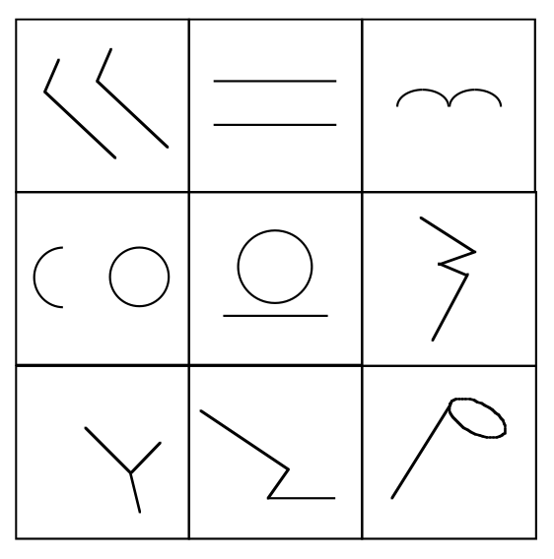
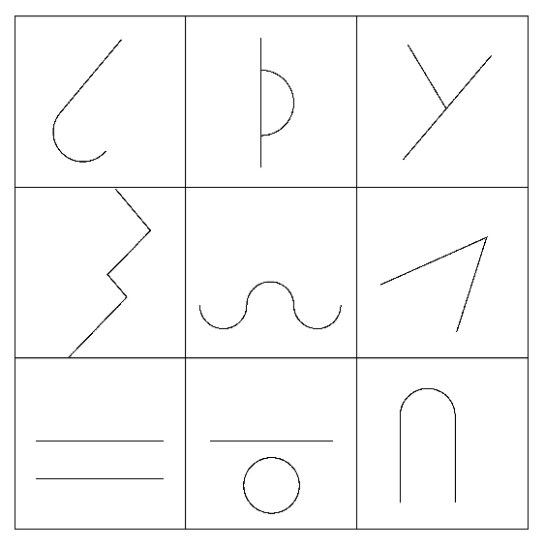
Shape Completion Exercise – Unlocking Creativity
Notes:
In this creativity exercise, participants are asked to complete as many shapes as possible in under five minutes. Each participant receives a canvas with a grid, either the one on the left or the one on the right. After the five minutes are up, we have a debrief on the drawings submitted by the participants. The goal of the exercise is to enhance creativity.
See next slide

Slide 31
Shape Completion Exercise – Unlocking Creativity
Why Use Shape Completion in Ideation?
Activates Visual Thinking: Encourages non-linear, intuitive problem-solving.
Breaks Mental Blocks: Shifts focus from logical constraints to freeform creativity.
Fosters Divergent Thinking: Helps generate unexpected ideas by interpreting abstract forms.
Exercise Instructions:
Distribute Incomplete Shapes 🖍️
Provide participants with simple, abstract shapes (e.g., half circles, squiggly lines, dots).
Set a Time Limit ⏳
Give 3-5 minutes for participants to complete the shapes into recognizable forms.
Encourage Wild Interpretations 🔍
There are no wrong answers! Encourage drawing whatever comes to mind.
Share and Discuss 💬
Have participants explain their drawings and how they arrived at their ideas.
Apply to a Design Challenge 🚀
Ask: How can this exercise help us think differently about our current problem?
Notes:
explanation of the creativity exercise.

Slide 32
5. Get Feedback

Slide 33
Share your solutions & capture feedback
10min ^{(2 sessions x 5 minutes each)}
Switch roles & repeat sharing.
Notes:
“Now it’s time to share your sketches with your partner!”
“Partner A, share your sketches with Partner B first, and then we will tell you to switch after four minutes.” Tell them to note likes/dislikes and builds on the idea, but also listen for new insights.
“Spend the time listening to your partners reactions and questions.” “This is not just about validating your ideas.”
“Fight the urge to explain and defend your ideas.”
“This is another opportunity to learn more about your partner’s feelings and motivations.”
Tell them to switch after time is up for the first session.

Slide 34

Don't cling to your solution
https://therefreshedhome.com/be-the-let-it-go-elsa/
Disney
Notes:
You have to let go and not cling too tightly to your solution. You must accept that it will be challenged by the user.

Slide 35
Iterate based on feedback
Reflect & generate a new solution. 3min
Sketch your big idea, note details if necessary!
Notes:
How to facilitate this step
They’ve had a chance to share their sketches with their partners and collect feedback.
“Now, take a moment to consider what you have learned both about your partner, and about the solutions you generated.” “From this new understanding of your partner and his or her needs, sketch a new idea.”
Tell them this solution may be a variation on an idea from before or something completely new.
They are still addressing a problem statement that they articulated, but you might point out that their previous problem statement may need to change to incorporate the new insights and needs they discovered.
“Try to provide as much detail and color around your idea as possible.” “How might this solution fit into the context of your partner’s life?”
“When and how might they handle or encounter your solution?”
While participants are working, grab the prototyping materials if you have not already.

Slide 36
Build your solution
Make something your partner can interact with!
[not here]
7min
Notes:
Tell participants to use the idea they just sketched as a blueprint for a tangible manifestation of their solution.
“Create a paper prototype of your solution.”
Explain that they should not simply make a scale model of their idea to explain the idea.
They should create an experience that their partner can react to. They could decide to test just one aspect of the overall solution.
“MAKE something that your partner can engage and interact with.” “If your solution is a service or a system, create a scenario that allows your partner to experience this innovation.”
“Use whatever materials are available to you—including space!”
Provide some urgency and excitement in your voice—you want to get them building immediately. “Be scrappy and quick—you only have a few minutes!!

Slide 37
Share your solution and get feedback
8min (2 sessions x 4 minutes each)
+ What worked...
- What could be improved...
? Questions...
! Ideas...
Notes:
Share your solution and get feedback
Explain that one partner will have time to share and collect feedback, and then they will switch so the other partner can share.
“Now you’re going to have the opportunity to share your prototype with your partner.”
Validation of the prototype is not the point—it should be an artifact that facilitates a new, targeted conversation.
“When you test, LET GO of your prototype, physically and emotionally.”
“Your prototype is NOT PRECIOUS, but the feedback and new insights it draws out are!” “Don’t defend your prototype; instead, watch how your partner uses and misuses it.”
Tell them to jot down things their partner liked and didn’t like about the idea, as well as questions that emerged and new ideas that came up.

Slide 38
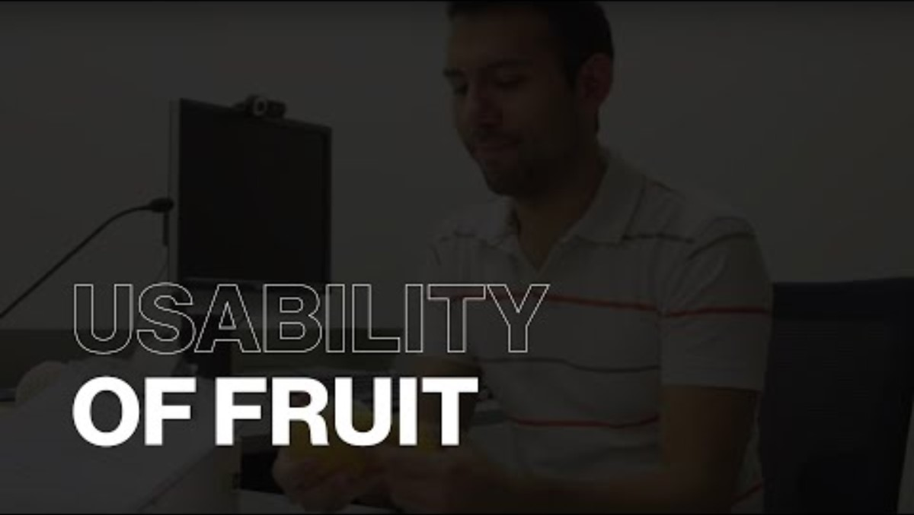
Understanding Usability Testing Through Usability of Fruits 🍌🍉
What is Usability Testing?
Observing Real User Behavior 👀: Watching how people interact with a product without guidance.
Identifying Pain Points ❌: Noticing where users struggle, hesitate, or make errors.
Gathering Insights for Improvement 🔄: Using findings to refine the design.
https://www.youtube.com/watch?time_continue=101&v=3Qg80qTfzgU&embeds_referring_euri=https%3A%2F%2Fhubblecontent.osi.office.net%2F&source_ve_path=Mjg2NjY
Notes:
Here, we introduce the concept of user testing. To introduce this concept, we rely on the video that shows user tests using fruits.

Slide 39
Understanding Usability Testing Through Usability of Fruits
Lessons from Usability of Fruits Video
This playful experiment demonstrates usability principles by testing how easy (or difficult) it is to "use" different fruits:
Affordance Matters – Can users tell how to interact with it? (e.g., peeling a banana vs. a pineapple)
Expectation vs. Reality – Do people interact with it the way designers intended?
Feedback is Key – Does the product provide clear signals when used correctly or incorrectly?
Iterate & Improve – If something isn’t intuitive, how can it be redesigned to be more user-friendly?
How This Relates to Digital Products
Navigation = Peeling a Fruit: If users struggle to figure out how to "open" a feature, there’s a usability issue.
Error Prevention = Seedless Experience: Removing unnecessary obstacles leads to a smoother journey.
User-Centered Design = Choosing the Right Fruit: A great product matches user needs and expectations.
Notes:
We're debriefing here on the video we watched about user testing with fruits.

Slide 40
User Test: tips and tricks
Measure
Task oriented
Count the number of clicks, the time required, and the number of elements remembered.
Structure your interview with 3 to 4 activities.
Patience
Comfort
Plan breaks between tasks.
You are testing the interface, not the user. Make sure to tell them.
Think Aloud
Call
Encourage the user to explain what they are doing, why, or why not.
Start by setting the tone: “Imagine that…”
Listen
Contextualize
Let the user speak (80% of your time should be spent listening).
Give enough information to start, but without guiding the user.
Notes:
Here, we present tips and tricks related to user testing. The most important thing is to listen.

Slide 41
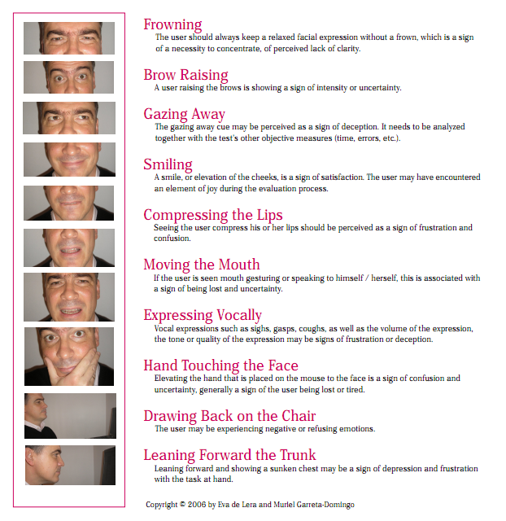
10 Heuristics for Observing Behavioral Reactions
https://www.scienceofpeople.com
Notes:
A chart for observing facial eyebrows is presented. The most important aspect is the frown, as it either indicates that the person doesn't understand or that they are very interested.

Slide 42
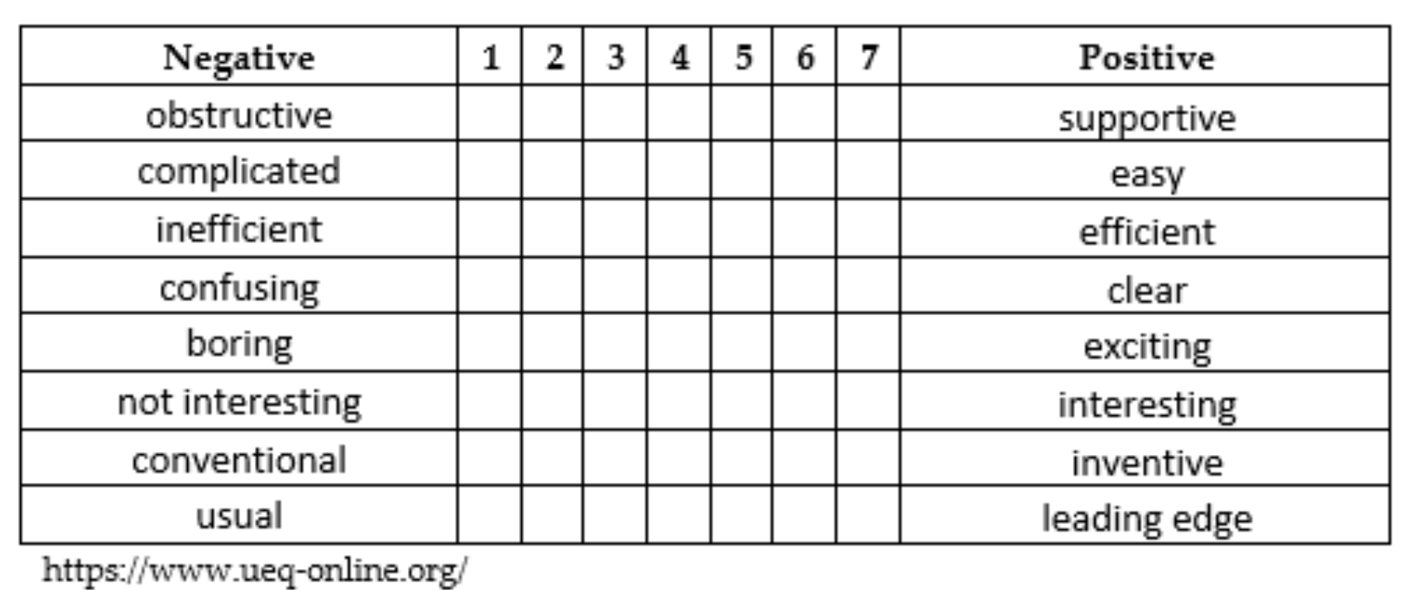
User Experience Questionnaire
Notes:
Here is the User Experience Questionnaire. This standardized questionnaire is available in several languages. It allows for the objectification and quantification of the user experience.

Slide 43
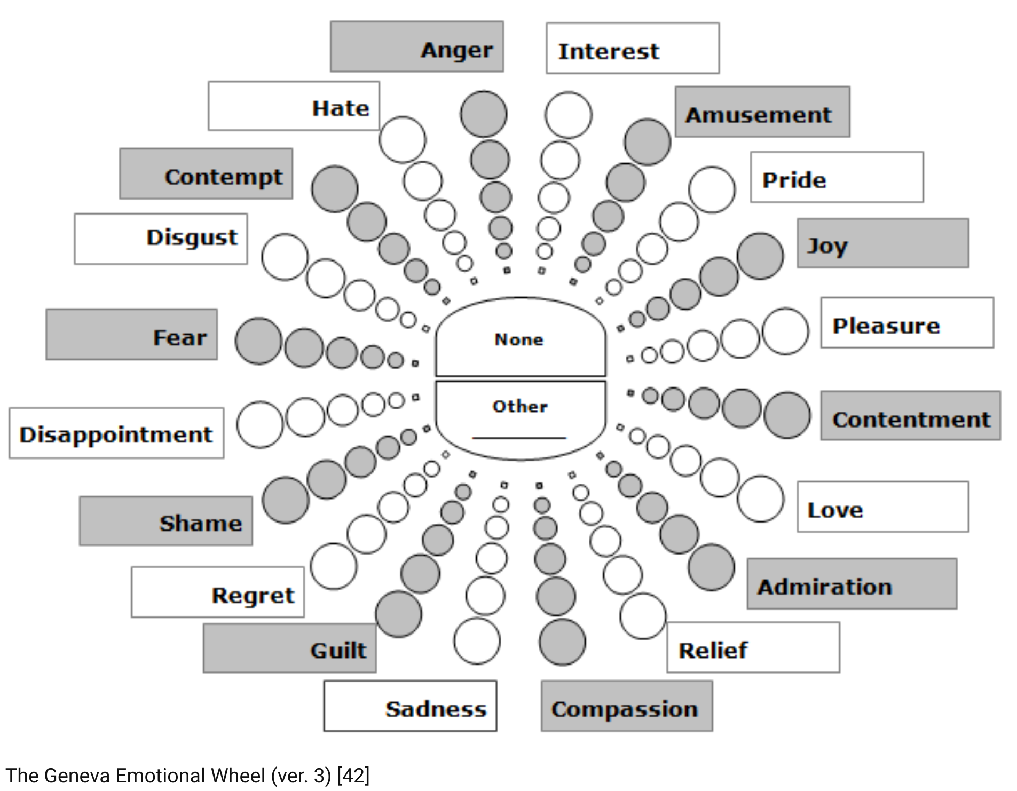
Geneva Emotion Wheel
Notes:
Here we present Geneva's wheel of emotions. It's a standardize
Geneva's Wheel of Emotions is a visual tool designed to help us better understand and express our emotions.
It was developed by psychology researchers, notably as part of the Geneva Emotion Wheel (GEW).
🌀 Simple explanation: The wheel presents different basic emotions, organized in a circle. Each emotion is placed according to: Its intensity (from the center outwards: the further towards the edge, the stronger the emotion), Its positive or negative nature.
🎭 Examples of emotions on the wheel: Positive: joy, interest, pride, tenderness, relief Negative: fear, anger, sadness, shame, disgust.
🎯 What's it for? Better identify your feelings, Express your emotions more precisely, Better understand the emotions of others (useful in psychology, management, emotional design, etc.).

Slide 44
6. Conclusions
Notes:
Group gather and debrief
This step is important! A well facilitated reflection has the power to turn this exercise from simply a fun activity to a meaningful experience that could impact the way participants approach innovation in the future. Quickly pull together a few tables that everyone can gather around.
Tell everybody grab their prototypes and set them on the table in the middle of the room.
“We’re going to huddle around and see what innovations you’ve created for your partners!”
“Who had a partner who created something that you really like?” “Who sees something they are curious to learn more about?”
Ask for the person who created the prototype and engage them in the conversation.
“How did talking to your partner inform your design?”
“How did testing and getting feedback impact your final design?” “What was the most challenging part of the process for you?”
The key to leading this conversation is to relate the activity to the big takeaways you want to illustrate. Some of core values of design thinking that would be great to draw out include:
Human-centered design: Empathy for the person or people you are designing for, and feedback from users, is fundamental to good design.
Experimentation and prototyping: Prototyping is not simply a way to validate your idea; it is an integral part of your innovation process. We build to think and learn.
A bias towards action: Design thinking is a misnomer; it is more about doing that thinking. Bias toward doing and making over thinking and meeting.
Show don’t tell: Creating experiences, using illustrative visuals, and telling good stories communicate your vision in an impactful and meaningful way.
Power of iteration: The reason we go through this exercise at a frantic pace is that we want people to experience a full design cycle. A person’s fluency with design thinking is a function of cycles, so we challenege participants to go through as many cycles as possible—interview twice, sketch twice, and test with your partner twice. Additionally, iterating solutions many times within a project is key to successful outcomes.

Slide 45

Most teams expect to succeed on the first try.
Notes:
Many teams believe they can successfully innovate their products or services on the first try. They usually rely on what they think.

Slide 46
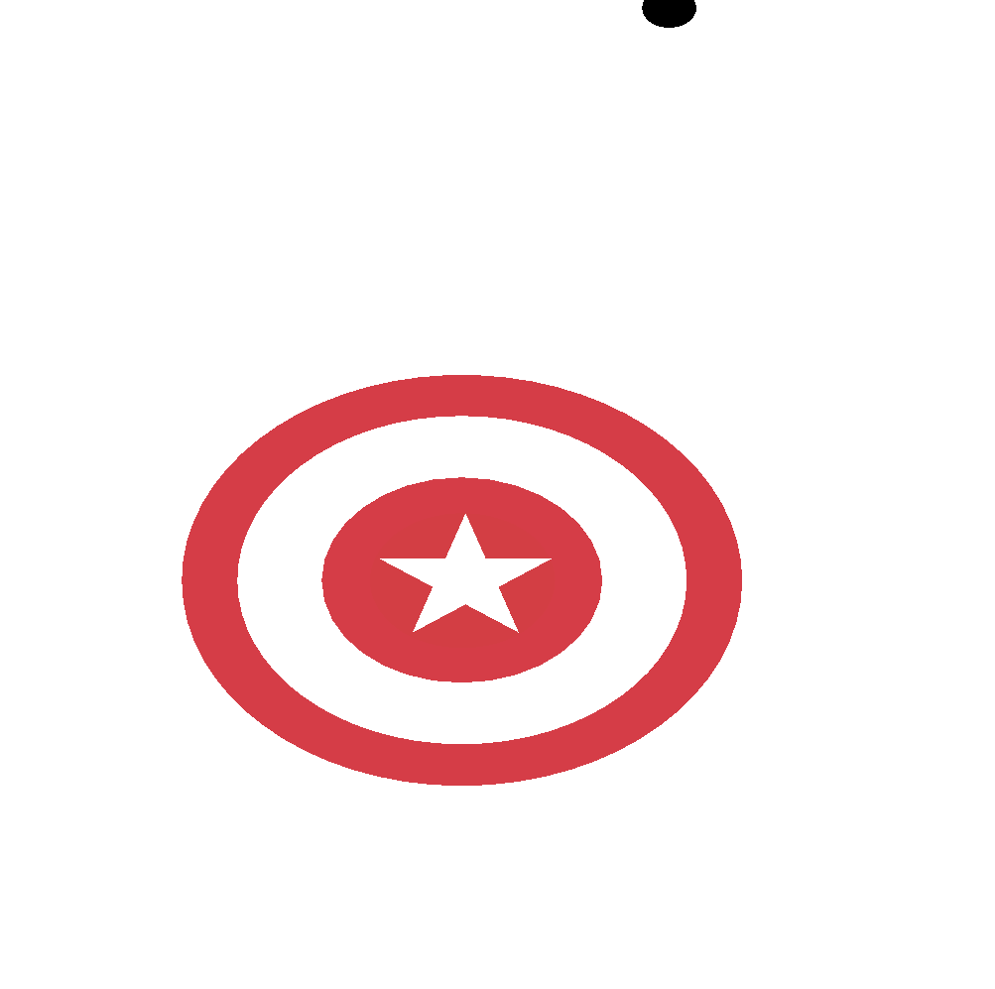
But, in reality, that is not the case.
Notes:
But in reality, they fail because they miss the true needs of the users.

Slide 47
In 99% of cases, you are not the user.
Notes:
In most cases, the designers or product and service managers are not the users.

Slide 48
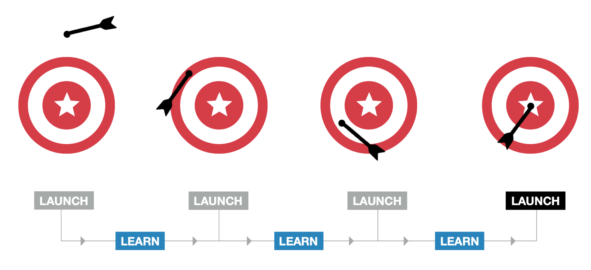
An iterative process helps meet user needs
Notes:
To minimize this risk, we use Lean or Agile methods, where we perform regular iterations. This ultimately allows us to meet user needs while minimizing risk.

Slide 49

Patricia Moore: Designing with Empathy
Radical Experiment (1970s)
Disguised as an 80-year-old woman for three years
Used prosthetics to simulate arthritis, cataracts, and mobility issues
Insights Gained Through Immersion
Experienced real-world barriers and struggles of aging
Understood physical and emotional challenges firsthand
Impact on Design
Advocated for inclusive & accessible design
Inspired products that better serve all ages & abilities
Key Lesson: Empathy Drives Innovation ️
Designing for users starts with understanding them
Immersion helps break assumptions & create truly user-centered solutions
Medium
Notes:
Here we introduce the experience of Patricia Moore. Participants are asked to guess Patricia Moore's age in the photo. In reality, Patricia Moore in the photo is in her twenties. Her objective was to design products for the elderly and disabled. Patricia works in the industrial sector. For 3 years, she dressed and lived like an elderly person. This helped her empathize. She discovered new needs and, after her experience, imagined solutions you're familiar with. For example, the vertical fridge handle or the non-slip features on your kitchen utensils.

Slide 50
The Design Thinking Process
Diverge
Create opportunities
1
3
5
Empathize
Ideation
Test
2
4
Definition
Prototype
Converge
Make choices
JEMS
Notes:
Here we present the Design Thinking process, with its different phases: empathy, which means understanding user needs, then definition, which means focusing on a few user problems, then ideation, which means imagining solutions, followed by prototyping, which involves turning ideas into something tangible, and finally testing, which means confronting the imagined solution with user feedback. At the top, we have the divergence phases, which means creating opportunities and exploring possibilities. At the bottom, we have the convergence phases, which means narrowing down to something more specific.

Slide 51
Summary
You've just completed the Design Thinking lesson — one of the most powerful approaches to creative problem-solving in UX.
In this session, we explored how to empathize with users, define clear problems, ideate innovative solutions, prototype quickly, and test with real feedback. You learned that design isn’t just about making things pretty — it’s about solving the right problems for real people.
Design Thinking is collaborative, iterative, and human-centered. It encourages you to stay curious, experiment boldly, and learn from failure.
Carry this mindset with you. It will help you tackle any UX challenge with empathy, structure, and creativity.

Slide 52
RESSOURCES & ADDITIONAL READING
https://batux.design/
BATUX is an infographic project by Marc Morera that applies user-centered design principles to reimagine Batman's iconic costume. The project walks through various UX design stages, including user research, problem identification, ideation, and solution development. It humorously explores the challenges faced by Batman in his suit, such as limited head movement, and encourages creative problem-solving to enhance the functionality of the Batsuit.
https://thedesignteam.io/the-design-process-67df3e8ec68f#.eigaj1d3y
This article by Pablo Stanley humorously explores the inconsistencies and challenges in the UX design field. It highlights the varying design processes across companies, the overuse of jargon, and the constant evolution of design tools and methodologies. Stanley compares the current state of UX to puberty, emphasizing the field's growth and experimentation. He encourages designers to work together to mature the industry, acknowledging the increasing recognition of design's importance in the tech world.
https://www.designkit.org//methods.html
Design Kit offers a comprehensive collection of human-centered design methods, presented as a practical and repeatable approach to innovative problem-solving. The website provides a step-by-step guide to unleash creativity and place the people you serve at the center of the design process. It covers various stages of the design process, including framing challenges, conducting research, ideation, prototyping, and implementation. The methods are organized into categories such as inspiration, ideation, and implementation, offering tools like interviews, journey mapping, brainstorming, and prototyping techniques. This resource is valuable for designers, researchers, and innovators looking to apply human-centered design principles to create impactful solutions.

Slide 53
RESSOURCES & ADDITIONAL READING
https://medium.com/sap-design/3-virtual-tools-to-boost-ux-maturity-in-your-team-376d6e0c6989
This article discusses three free tools from SAP AppHaus' Innovation Toolkit to enhance UX maturity in teams. The first tool is the Design Thinking Leporello, a printable template for hands-on design thinking experiences. The second is Scenes, a method for creating storyboards to visualize product ideas in context. The third is the Innovation Toolkit for Virtual Collaboration Bundle, which includes various methods and exercises to foster innovation in remote teams. These resources aim to help organizations become more user-centered and integrate design into all aspects of the customer experience.
https://feature.ideo.com/a-cafeteria-designed-for-me/
IDEO collaborated with the San Francisco Unified School District (SFUSD) to redesign their school lunch program, focusing on creating a student-centered experience rather than just improving food quality. The project involved over 1,300 stakeholders, including students, parents, staff, and community groups, to address low participation rates in school lunches. IDEO developed innovative solutions such as redesigned cafeteria spaces, interactive meal ordering systems, and curriculum integration of food education. The redesign also included a phased business model to ensure financial sustainability. Key features of the new system include community kitchens, round tables for elementary students, central warehousing for fresh food, and mobile carts for convenient meal access. This comprehensive approach aimed to transform the entire school food ecosystem, improving both nutrition and student engagement.

